Slide 1



Transition to R Pros&Cons from a EU Field Epidemiology Training Programme Perspective
Irina Czogiel
RECON Meeting
London, March 23rd 2018

Slide 2
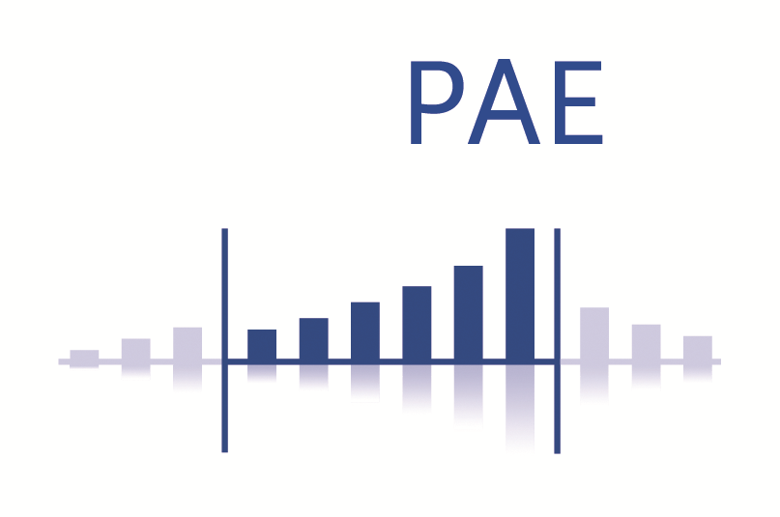
Me…
… before
Formal degree in Statistics
Postdoc in Bioinformatics
R user since 2001 (…. feeling old)
… these days
Since 2014 at Robert Koch Institute, Department for Infectious Disease Epidemiology
Main Activity: Project Supervision and Teaching in context of Field Epidemiology Training Programmes
(PAE@RKI & EPIET&EUPHEM@ECDC )

Slide 3
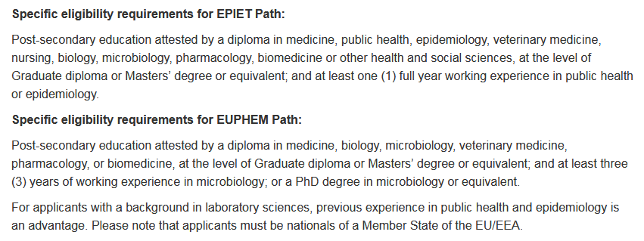
EPIET/EUPHEM - Who we want
eligibility criteria for cohort 2018

Slide 4
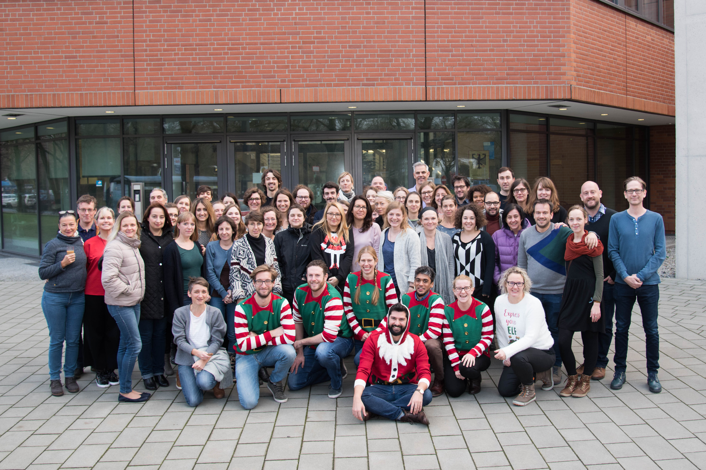
EPIET/EUPHEM - Who we get

Slide 5
EPIET/EUPHEM - What we do
Theory Modules
Introductory Course
Outbreak investigation module
Multivariable Analysis
Vaccinology
Time-Series Analysis & Surveillance
Rapid Assessment and Survey methods
Biorisk and Quality Management
Initial Management in Public Health Microbiology
Project Review
RKI Lab4Epi
Learning by Service @ site
Surveillance
Applied Research
Routine Work
National Outbreak Response
Miscellaneous
International Outbreak Response
Teaching
…
+

Slide 6
Use of Statistical Software in OIM
To accomplish…
Read in data
Quality check data
Correct Mistakes
Label data
Handling time formats
Generate new variables (e.g. case definition using logic operators)
Simple univariable und stratified analyses to find (adjusted) RRs/ORs
… in STATA
case study format

Slide 7
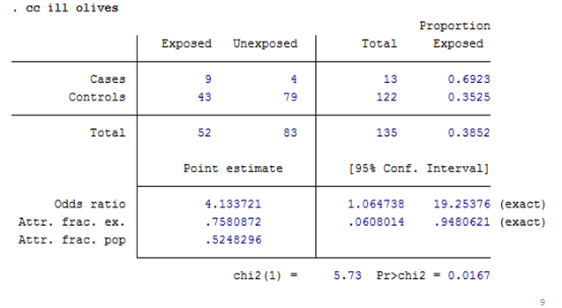
Glimpse of STATA

Slide 8
Use of Statistical Software in OIM
To accomplish…
Read in data
Quality check data
Correct Mistakes
Label data
Handling time formats
Generate new variables (e.g. case definition using logic operators)
Simple univariable und stratified analyses to find (adjusted) RRs/ORs
… in STATA
case study format

Slide 9
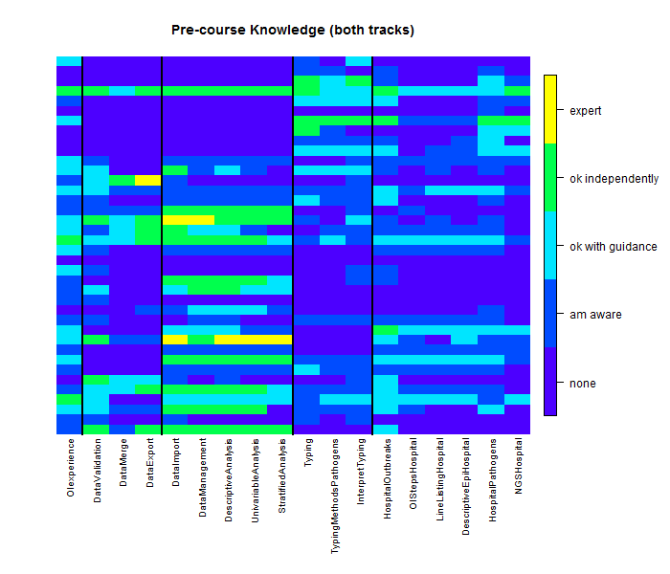
Use of Statistical Software in OIM
To accomplish…
Read in data
Quality check data
Correct Mistakes
Label data
Handling time formats
Generate new variables (e.g. case definition using logic operators)
Simple univariable und stratified analyses to find (adjusted) RRs/Ors
… in STATA
Precourse knowlegde
case study format

Slide 10
Challenges (during OIM)
as it is:
very diverse group in terms of pre-exposure to both statistical software and methods
options:
split into homogeneous subgroups (don‘t want that, would increase gap)
keep big group (tried that in past, doesn‘t work well)
split into heteregenous subgroups (current approach, peer-to-peer learning)
pre-course learning (plan to increase/improve for future)
with R:
gap would be even bigger (R users also tend to be more experienced in methodology)
no agreed-on standard how to do data management and basic descriptive epi (peer-to-peer learning not ideal)

Slide 11
Pros/Cons (general)
Cons
common view: „Not very intuitive for non-statisticians (less intuitive than Stata?)“
therefore: „not enough time for teaching it face-to-face during 10 weeks theory training (less time for other topics?)“
for beginners: too many ways to do things
especially early steps (data management/descriptive epi) can be cumbersome
not much dedicated training material for field epi
not enough people firm enough to teach in modules/to supervise projects when analysis is conducted with R
Pros
more stats/computer literate people each year
R becomes more and more well-known, people actively request R
more advanced topics (regression and „onwards“) can be done with well-established packages
for advanced users: a lot more flexibility
easy to integrate e.g. phylogenetic analysis or spatial analysis
free of charge, can be used everywhere by everyone!!!!

Slide 12
Pros/Cons (general)
Cons
common view: „Not very intuitive for non-statisticians (less intuitive than Stata?)“
therefore: „not enough time for teaching it face-to-face during 10 weeks theory training (less time for other topics?)“
for beginners: too many ways to do things
especially early steps (data management/descriptive epi) can be cumbersome
not much dedicated training material for field epi
not enough people firm enough to teach in modules/to supervise projects when analysis is conducted with R
Pros
more stats/computer literate people each year
R becomes more and more well-known, people actively request R
more advanced topics (regression and „onwards“) can be done with well-established packages
for advanced users: a lot more flexibility
easy to integrate e.g. phylogenetic analysis or spatial analysis
free of charge, can be used everywhere by everyone!!!!

Slide 13
Way forward (personal opinion)
Cons
common view: „Not very intuitive for non-statisticians (less intuitive than Stata?)“
therefore: „not enough time for teaching it face-to-face during 10 weeks theory training (less time for other topics?)“
for beginners: too many ways to do things
especially early steps (data management/descriptive epi) can be cumbersome
not much dedicated training material for field epi
not enough people firm enough to teach in modules/to supervise projects when analysis is conducted with R
To Dos
decide basic approaches (ggplot2? tidyverse?)
develop easy to use and maintain R4epi package (that resembles STATA?)
translate existing training material using new standard
train the trainer

Slide 14
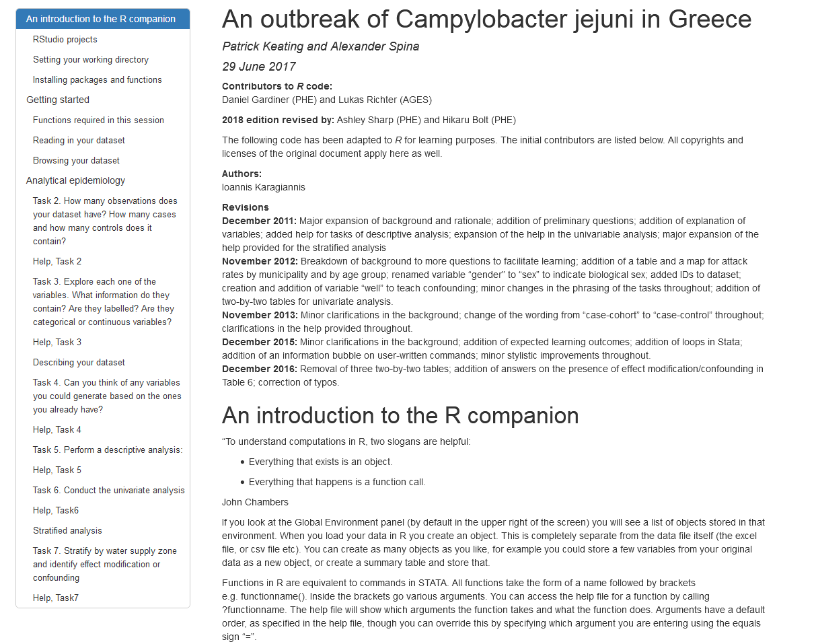
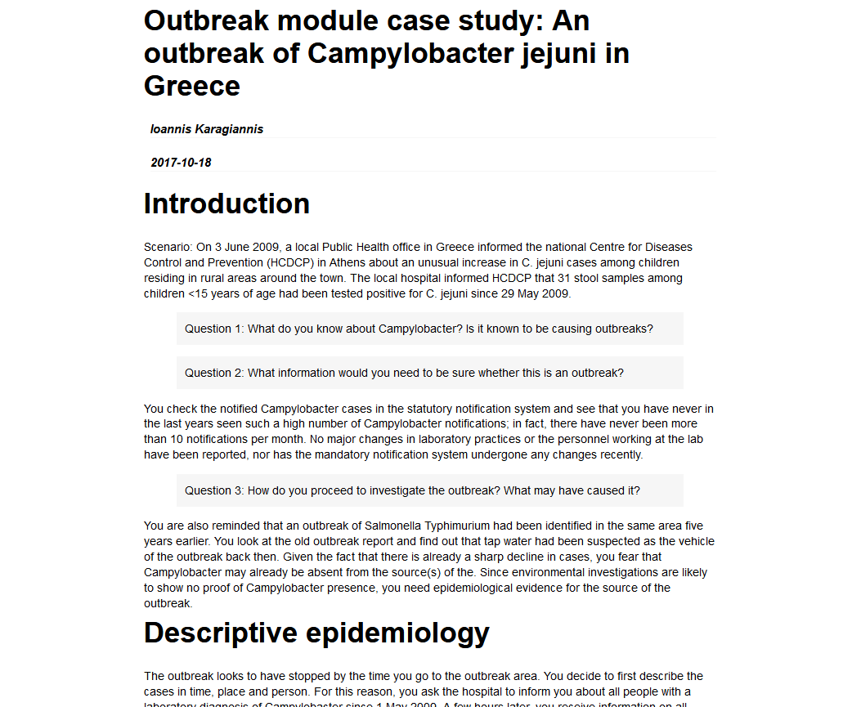
Work has been done…

Slide 15
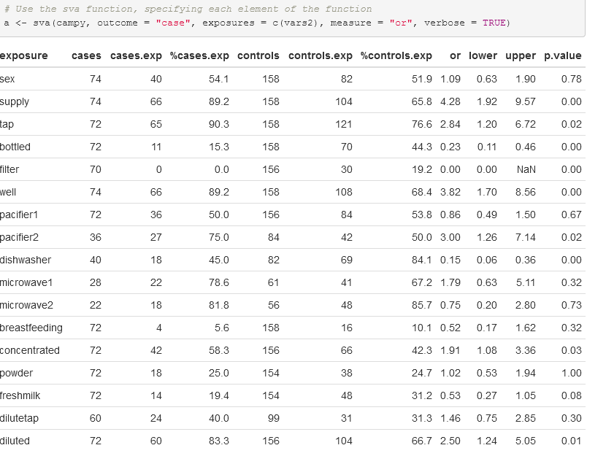
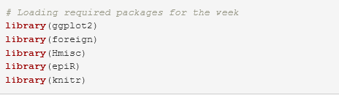
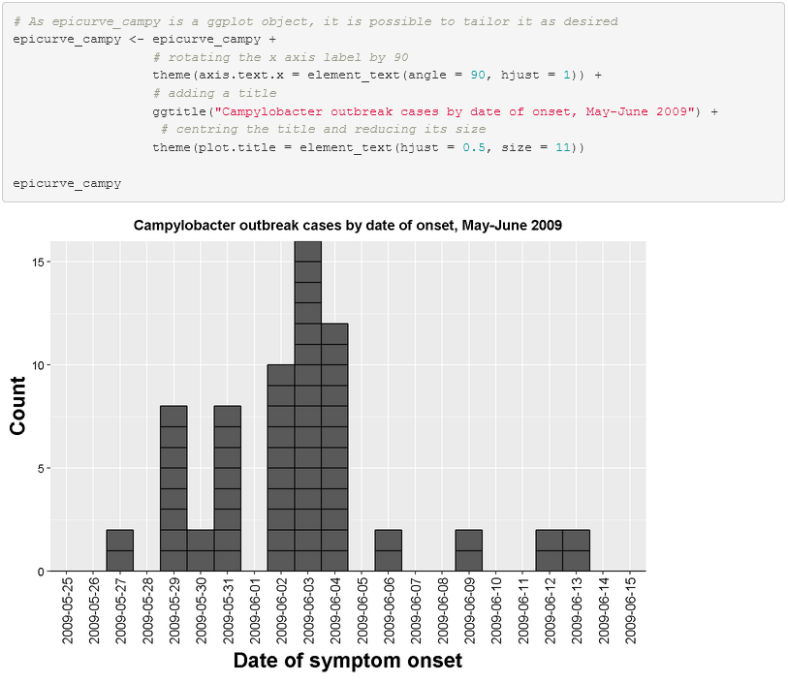
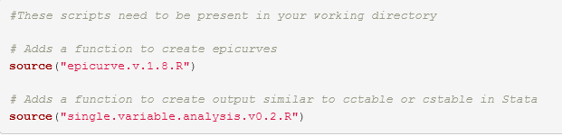
…but needs coordination!

Slide 16
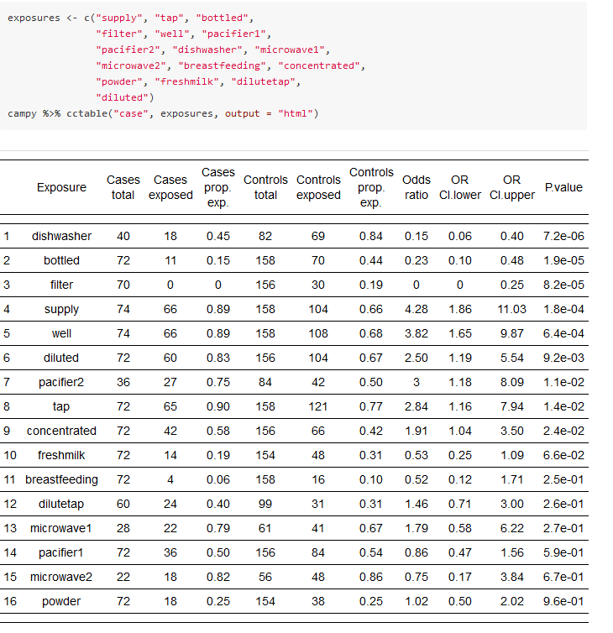
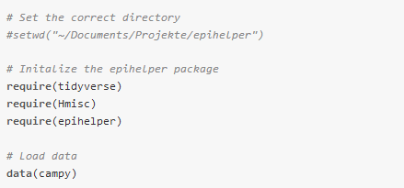
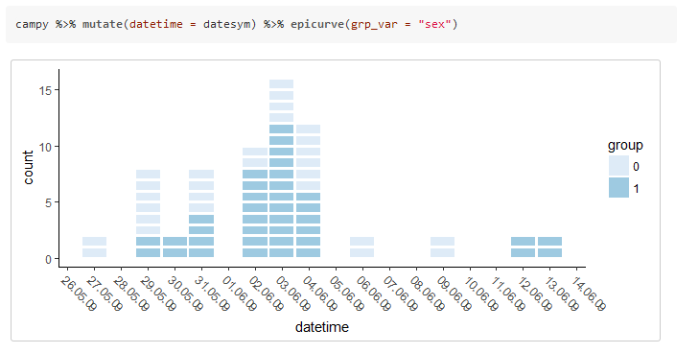
…but needs coordination!

Slide 17
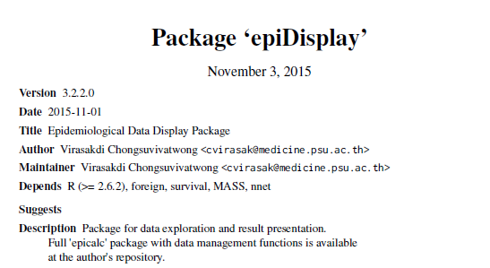
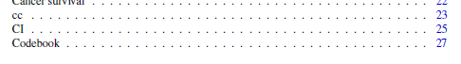
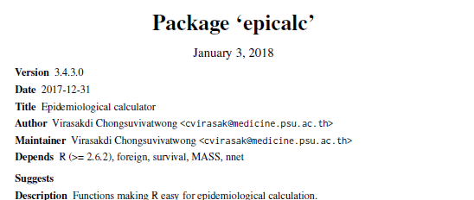
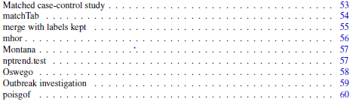
…but needs coordination!

Slide 18
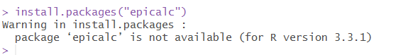
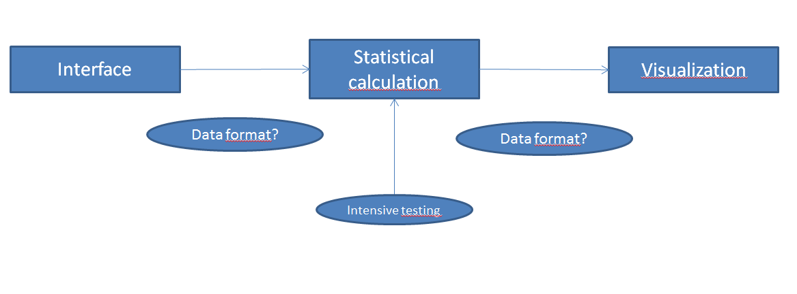
To be considered!
…and a lot more!

Slide 19

But in summary…

